Slide 1

月度IC推广专项会议
PRISEMI芯导授权代理分销经销KOYUELEC光与电子
联系电话：0755-82542001 82574660谢谢惠顾~
汇报人：陆宗
2025年1月13日

Slide 2
目 录
IC类型介绍
产品介绍
应用领域

Slide 3
IC产品类型
锂电池充电管理芯片
OVP过压保护芯片
音频功率放大器
DC/DC电源
负载开关芯片

Slide 4
产品介绍: 开关式充电芯片
Part Number | Control Topology | Power Path Support | I_{Charge_} _{Max.} | V_{IN} Operating Range | V_{IN} Overvoltage Threshold | Absolute V_{IN} | Battery Charge Voltage | F_{SW}of Buck (Typ.) | Maximum OTG Output Current | CTRL Interface | Package
 |  | (Y/N) | (A) | (V) | (V) | (V) | (V) | (MHz) | (A)
PSC5415E | Switch-Mode | N | 1.75 | 4.5-5.75 | 5.9 | 29 | 4.1-4.4 | 1.5/2.0 | 0.7 | I2C | WLCSP20
PSC5425E | Switch-Mode | N | 2.25 | 4.5-5.75 | 5.9 | 29 | 4.1-4.4 | 1.5/2.0 | 0.7 | I2C | WLCSP20
PB15206 | Switch-Mode | N | 2.5 | 4.3-5.5 | 6 | 7 | 3.6-4.43 | 1 | 2 | I2C | QFN3x3-20L
PB15302 | Switch-Mode | N | 2.2 | 4.5-5.5 | 5.9 | 29 | 4.1-4.4 | 1.5/2.0 | 0.7 | I2C | DFN3x3-12L
PB15303D | Switch-Mode | N | 2.2 | 4.5-5.5 | 5.9 | 32 | 4.1-4.4 | 1.0/1.5 | 0.7 | I2C | DFN3x3-12L
PB15305 | Switch-Mode | N | 2.0 | 4.3-5.5 | 6 | 7 | 3.6-4.43 | 1 | 2 | I2C | QFN3x3-20L
PSC2965/L | Switch-Mode | Y | 3.0 | 4.5-13.5 | 5.5-13.8 | 20 | 3.98-4.46 | 1.2 | 1.0 | I2C | QFN4x4-24L
PSC2966 | Switch-Mode | Y | 3.0 | 4.5-13.5 | 5.5-13.8 | 20 | 3.856-4.624 | 1.2 | 1.0 | I2C | QFN4x4-24L
PSC2985 | Switch-Mode | Y | 5.0 | 4.5-13.5 | 5.5-13.8 | 20 | 3.98-4.48 | 1.2 | 1.0 | I2C | QFN4x4-24L

Slide 5
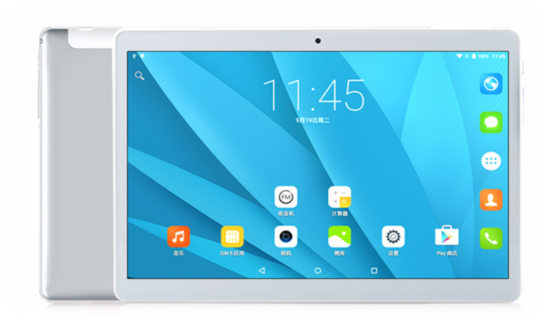
产品介绍: 开关式充电芯片-PSC5425E-竞品
品牌 | 型号 | 是否pin对pin | I_{Charge_} _{Max.} | V_{IN} Operating Range | V_{IN} Overvoltage Threshold | Absolute V_{IN} | Battery Charge Voltage | 外部电感 | Maximum OTG Output Current | CTRL Interface | Package
 |  | (Y/N) | (A) | (V) | (V) | (V) | (V) | (uH) | (A)
芯导 | PSC5415E | Y | 1.75 | 4.5-5.75 | 5.9 | 29 | 4.1-4.4 | 1uH | 0.7 | I2C | WLCSP20
芯导 | PSC5425E | Y | 2.25 | 4.5-5.75 | 5.9 | 29 | 4.1-4.4 | 1uH | 0.7 | I2C | WLCSP20
TI | BQ24157S | Y | 1.55A | 4.5-5.75 | 6.5 | 20 | 3.5-4.44 | 1uH | 0.3 | I2C | WLCSP20
希荻微 | HL7007/5 | ？ | 2.5A/1.5A |  |  | 20 | 2.5-4.5 | 1uH | 1 | I2C | WLCSP20
广芯 | BCT24157 | Y | 1.5A | 4.3-6.2 | 6.2 | 24 |  | 1uH | 0.7 | I2C | WLCSP20
安森美 | FAN5401X | Y | 1.45 |  |  | 20 |  | 1uH |  | I2C | WLCSP20
推广领域：手机，平板

Slide 6
产品介绍: 开关式充电芯片-PSC2966-竞品
品牌 | 型号 | 是否pin对pin | I_{Charge_} _{Max.} | V_{IN} Operating Range | V_{IN} Overvoltage Threshold | Absolute V_{IN} | Battery Charge Voltage | 外部电感 | Maximum OTG Output Current | CTRL Interface | 最低待机 （ua） | Package
 |  | (Y/N) | (A) | (V) | (V) | (V) | (V) | (uH) | (A)
芯导 | PSC2965/L | Y | 3.0 | 4.5-13.5 | 5.5-13.8 | 20 | 3.98-4.46 | 1 | 1.0 | I2C | Tpy=30 | QFN4x4-24L
芯导 | PSC2966 | Y | 3.0 | 4.5-13.5 | 5.5-13.8 | 20 | 3.856-4.624 | 1 | 1.0 | I2C | Tpy=0.7 | QFN4x4-24L
TI | BQ25601 | Y | 3.0 | 3.9-13.5 | 6.1~14.85 | 22 | 3.856-4.624 | 1 | 1.2 | I2C | Max=5 | QFN4x4-24L
钰泰 | ETA6953/63 | Y | 3.0 | 3.9-13.5 | 6.5~14 | 30 | 3.856-4.624 | 1 | 1.0 | I2C | Max=5 | QFN4x4-24L
矽力杰 | SY6974QCC | Y | 3.0 | 3.9-13.5 | 6.5~14 | 18 | 3.856-4.624 | 1 | 1.2 | I2C | Max=5 | QFN4x4-24L
圣邦微 | SGM41542/41 | Y | 3.87 | 3.9-13.5 | 6.5~14 | 22 | 3.856-4.624 | 1 | 2 | I2C | Tpy=0.1 | QFN4x4-24L
辰芯 | CX25601 | Y | 3.0 | 3.9-13.5 | 6.5~14 | 22 | 3.856-4.624 | 1 | 1.4 | I2C | Max=5 | QFN4x4-24L
推广领域：平板，鼠标键盘，音响，VR眼镜，按摩仪等

Slide 7
产品介绍: 开关式充电芯片-PB15303D-竞品
品牌 | 型号 | 是否pin对pin | I_{Charge_} _{Max.} | Absolute V_{IN} | Battery Charge Voltage | 电池耐压 | 外部电感 | 是否有电流采样电阻 | Maximum OTG Output Current | CTRL Interface | Package
 |  | (Y/N) | (A) | (V) | (V) | (V) | (uH) | (Y/N) | (A)
芯导 | PB15302 | Y | 2.2 | 29 | 4.1-4.4 | 7 | 1 | Y | 0.7 | I2C | DFN3x3-12L
芯导 | PB15303D | Y | 2.2 | 32 | 4.1-4.4 | 7 | 1 | Y | 0.7 | I2C | DFN3x3-12L
帝奥微 | DIO59020 | N | 2 | 26 | 4.2-4.4 | 6.5 | 1 | Y | 1 | I2C | DFN3x3-12L
微源 | LP4020 | N | 2.5 | 7 | 4.2 | 7 | 2.2 | Y | 0 |  | SOT23-6
微源 | LP4030 | N | 3 | 28 | 4.2 | 24 | 2.2 | Y | 0 |  | DFN-10
英集芯 | QP2332N | N | 2.4 | 30 | 3.65-4.5 | 7.5 | 1 | N | 0 |  | DFN8L-2X3
钰泰 | ETA6098 | N | 2.5 | 32 | 4.2 | 6 | 2.2 | Y | 0 |  | DFN3X3-10
推广领域：平板，鼠标键盘，音响，VR眼镜，按摩仪，电子烟，电动牙刷，对讲机，美容仪等

Slide 8
产品介绍: 线性充电芯片
Part Number | Control Topology | Power Path Support | I_{Charge_} _{Max.} | V_{IN} Operating Range | V_{IN} Overvoltage Threshold | Absolute V_{IN} | Battery Charge Voltage | 电池耐压 | Package
 |  | (Y/N) | (A) | (V) | (V) | (V) | (V) | (v)
PB15402 | Linear-Mode | N | 0.4 | 4.4-5.5 | - | 6 | 4.2 | 6 | SOP-8L
PLC4056E/D | Linear-Mode | N | 1 | 4.5-6 | 6.0 | 30 | 4.2 | 12 | ESOP-8L/ DFN3X3-8L
PLC40561 | Linear-Mode | N | 0.5 | 4.5-5.5 | 5.9 | 32 | 4.2 | 6.5 | DFN2x2-8L
PLC40561B | Linear-Mode | N | 0.5 | 4.5-5.5 | 5.9 | 32 | 4.35 | 6.5 | DFN2x2-8L
PLC40561C | Linear-Mode | N | 0.5 | 4.5-5.5 | 5.9 | 32 | 4.4 | 6.5 | DFN2x2-8L
PLC40561D | Linear-Mode | N | 0.5 | 4.5-5.5 | 5.9 | 32 | 3.6 | 6.5 | DFN2x2-8L
PLC40561T | Linear-Mode | N | 0.8 | 4.55-5.5 | 5.9 | 32 | 4.2 | 6.5 | SOT23-6L
PLC40561TB | Linear-Mode | N | 0.8 | 4.55-5.5 | 5.9 | 32 | 4.35 | 6.5 | SOT23-6L
PLC40561TC | Linear-Mode | N | 0.8 | 4.55-5.5 | 5.9 | 32 | 4.4 | 6.5 | SOT23-6L
PLC40561TD | Linear-Mode | N | 0.8 | 4.55-5.5 | 5.9 | 32 | 3.6 | 6.5 | SOT23-6L
推广领域：鼠标键盘，音响，按摩仪，电子烟，电动牙刷，对讲机，美容仪等

Slide 9
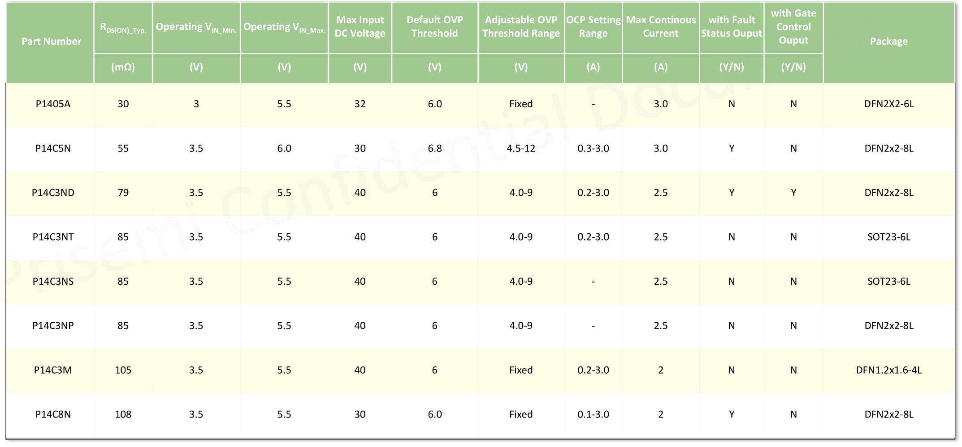
产品介绍OVP

Slide 10
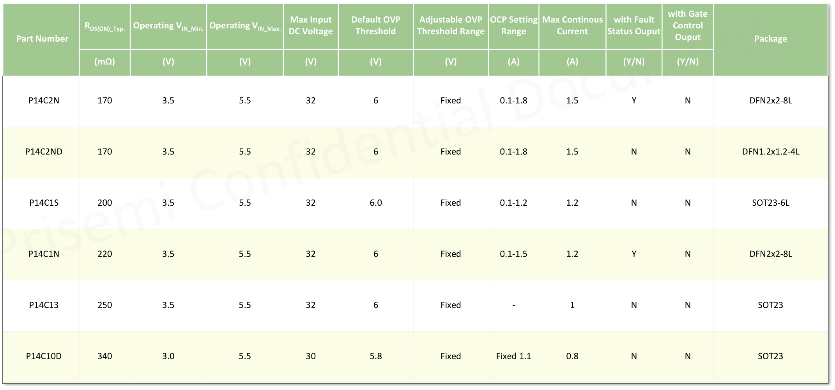
产品介绍OVP

Slide 11
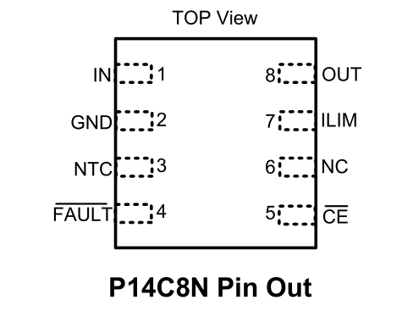
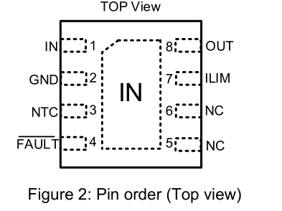
产品介绍OVP-P14C8N/NE
 | P14C8N/NE | P14C8NE3 | 爻火微 YHM2018（量产） | 思远 SY5323（送样改版）
封装 | DFN2*2-8 | DFN3x3-8L | DFN2*2-8 | DFN2*2-8
输入耐压 | +30V -10V | +30V -10V | +22V -30V | +30 -30
单体插拔能力 | 28V | 28V
是否兼容 | Pin-to-pin | no | Pin-to-pin | Pin-to-pin
过压响应时间 | 50ns | 50ns | 50ns | 50ns
导通阻抗 | 110mΩ | 112mΩ | 175mΩ | 220mΩ
过流保护 | 100mA-2A可调 | 100mA-2A可调 | 100mA-2A可调 | 100mA-1A可调
NTC | 有 | 有 | 无 | 无

Slide 12
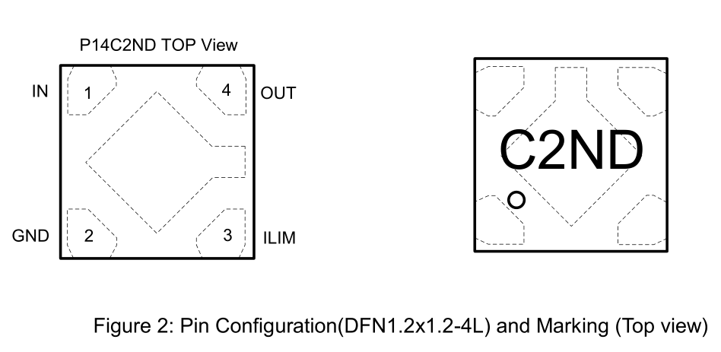
产品介绍OVP-P14C2ND
 | P14C2ND | 力芯微ET9612Y
封装 | DFN1.2x1.2-4L | DFN1.2x1.2-4L
输入耐压 | +30V | +36
是否兼容 | Pin-to-pin | Pin-to-pin
过压响应时间 | 50ns | 50ns
导通阻抗 | 170mΩ | 100mΩ
过流保护 | 100mA-1.8可调 | 1.1A锁定
NTC | 有 | 无

Slide 13
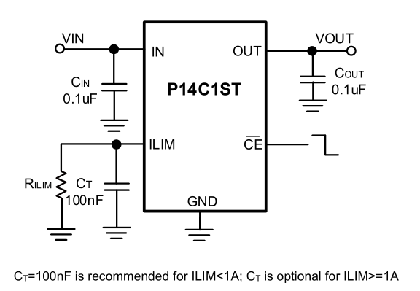
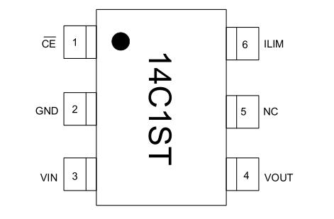
产品介绍OVP-P14C1ST
 | P14C1ST
封装 | SOT23-6L
输入耐压 | +26V
特性 | 和P14C1ST Pin
过压保护 | 固定6V
导通阻抗 | 200mΩ
过流保护 | 100mA-1.2可调
浪涌能力 | +170V, -40V
热插拔能力 | +26V

Slide 14
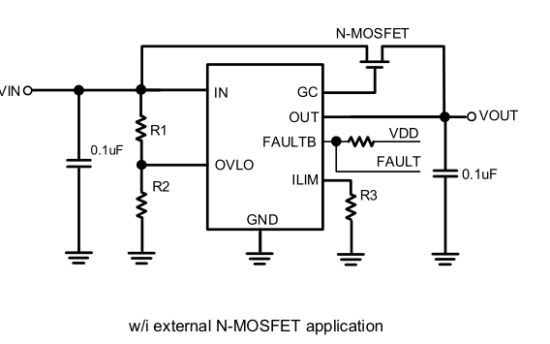
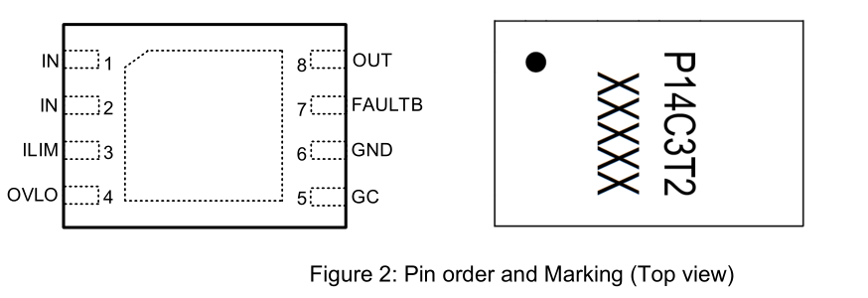
产品介绍OVP-P14C3T2
 | P14C3T2
封装 | DFN2x3-8L
输入耐压 | +24V
特性 | 集成浪涌管
过压保护 | 4.0V-9V,±3%
导通阻抗 | 105mΩ
过流保护 | 200mA-3可调
浪涌能力 | +450V, -240V
热插拔能力 | +24V

Slide 15
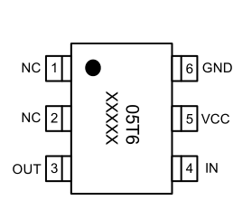
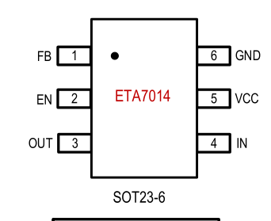
产品介绍OVP-P1405T6
 | P1405T6 | ETA7014
封装 | SOT23-6L | SOT23-6L
输入耐压 | -0.3 to 32 | -0.3V to 36V
是否PIN | Y | Y
过压保护 | 固定6V | 可调9V
导通阻抗 | 32mΩ | 35mΩ
过流保护 | Y | Y
EN使能 | N | 高使能
热插拔能力 | +24V | +28V

Slide 16
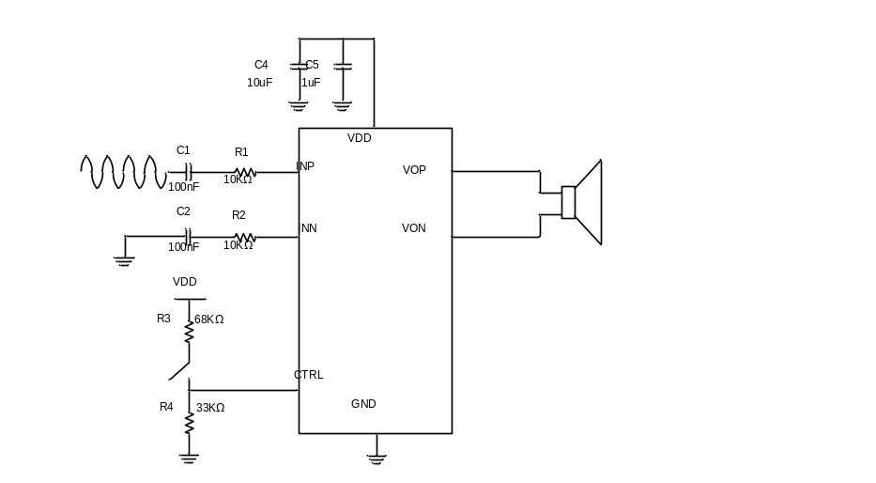
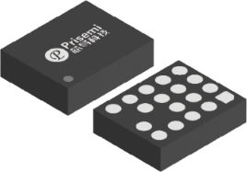
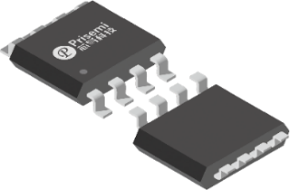
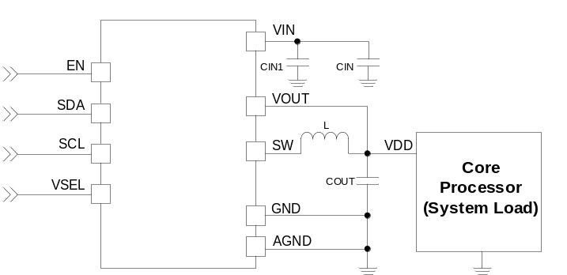
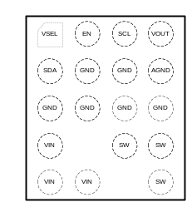
产品介绍: DC-DC&音频功率放大器
Prisemi Confidential Document
CTRL 1
8 VOP
Prisemi Confidential Document
NC 2
7 GND
INN 3
6 VDD
INP 4
5 VON
FCQFN2X1.7-18L
DC-DC
SOP-8L
音频功率放大器
DC-DC |  |  |  |  | DC-DC
Part Number | Operating V_{IN_ Min.} | Operating V_{IN_ Max.} | V_{Out_Min.} | V_{Out_Max.} | Programmable Voltage Step | Max Continous Ouput Current | Max Peak Ouput Current | Switching Frequency (Max.) | CTRL Interface | Package
 | (V) | (V) | (V) | (V) | (mV) | (A) | (A) | (MHz)
PM5355D | 2.7 | 5 | 0.6 | 1.41 | 12.8 | 5.0 | 6.5 | 2.2 | I2C | FCQFN2x1.7-18L
PM5355E | 2.7 | 5 | 0.6 | 1.23 | 10 | 5.0 | 6.5 | 2.2 | I2C | FCQFN2x1.7-18L
音频功率放大器 |  |  |  |  | 音频功率放大器
Part Number | Operating V_{IN_Min.} | Operating V_{IN_Max.} | P_{O_Max.} | Noise | THD+N @1W | PSRR @217Hz | Efficiency | Features | Package
 | (V) | (V) | (W) | (uVrms) | (%) | (dB) | (%)
PA8157 | 2.5 | 5.5 | 5 | 70 | 0.04 | 75 | 88 | AGC | SOP-8L

Slide 17
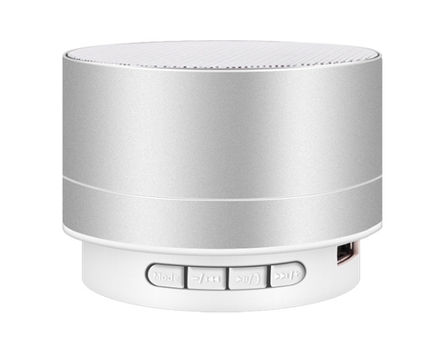
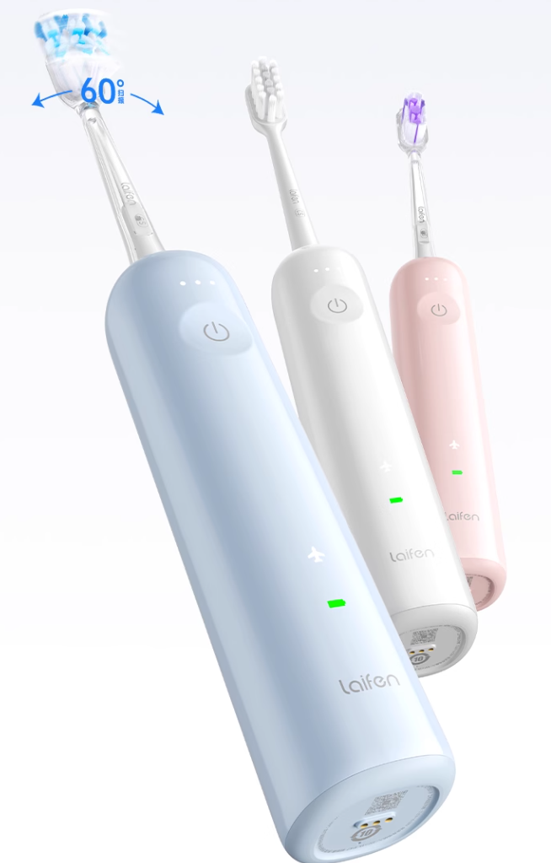
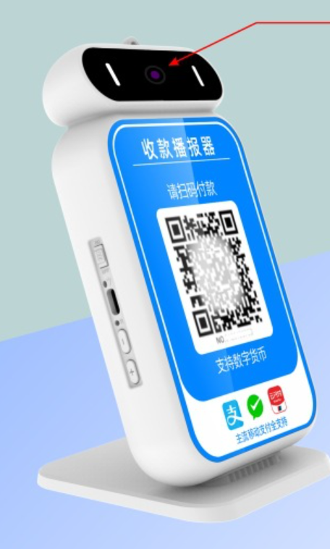
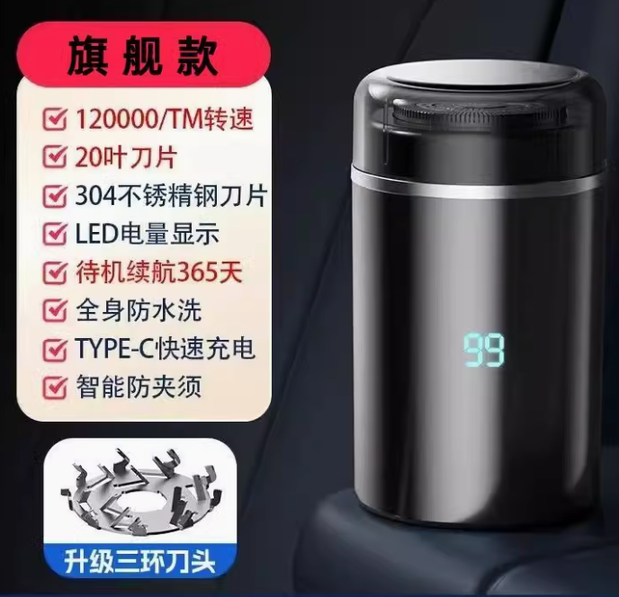
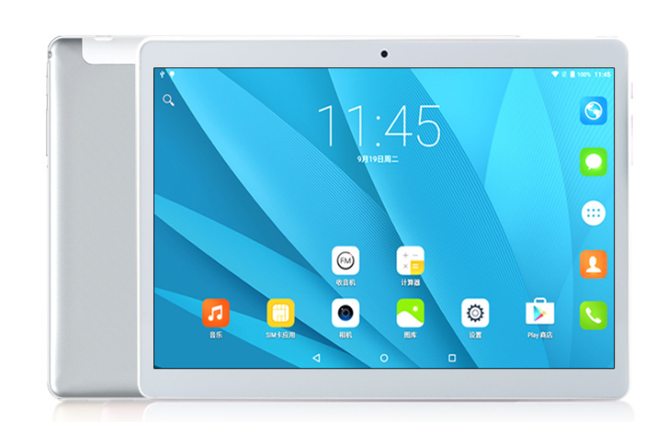
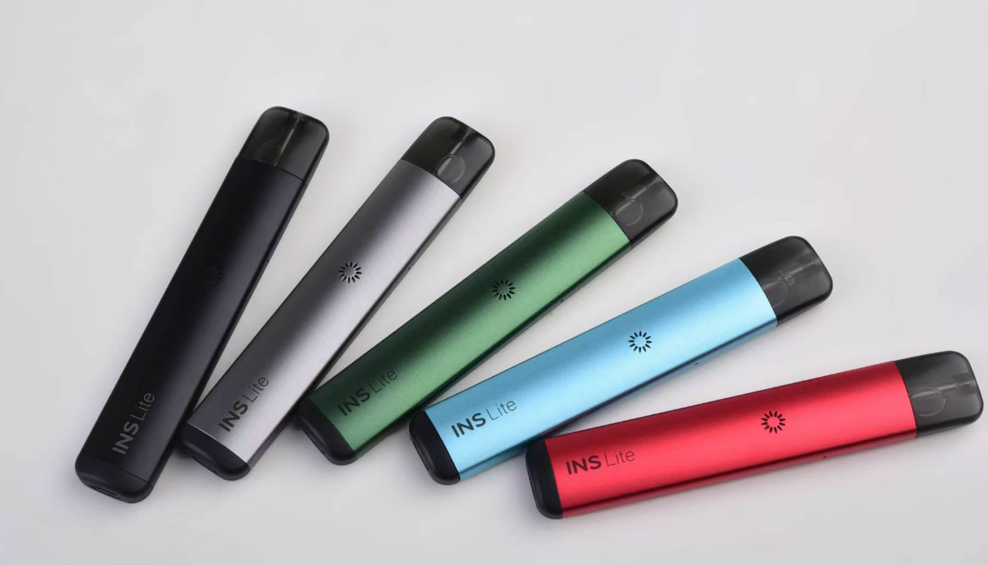
应用目标领域

Slide 18

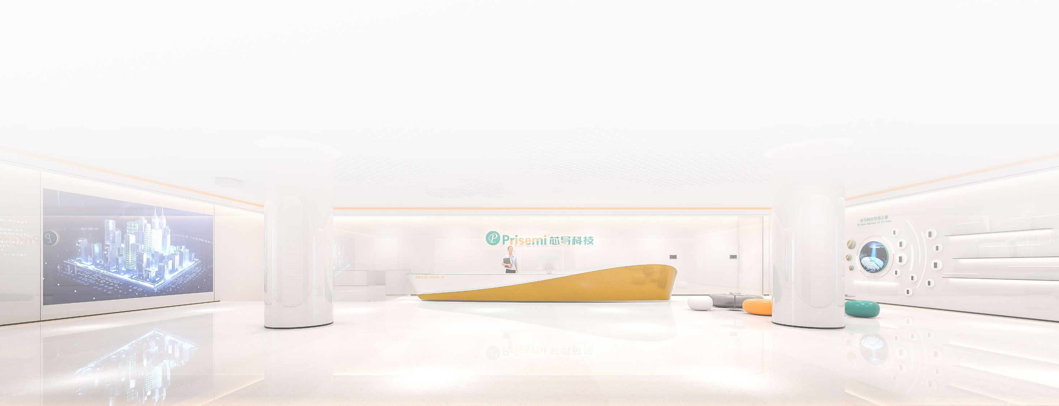
联系我们
网站：www.prisemi.com
邮箱：info@prisemi.com
总部：上海市浦东新区盛夏路565弄集贤天地D幢11层
西安：陕西省西安市高新区丈八一路1号汇鑫中心C座911室
无锡：无锡市经济开发区太湖街道震泽路688号1号楼701-702室
深圳：深圳市南山区粤兴二道10号香港中文大学李伟波楼906-908室
微信公众平台

