Slide 1
Lesson 99
Ow!

Slide 2
New Words and expressions
ow /au/ int. 哎呦
slip /slɪp/ v. 滑倒，滑了一脚
fall /fɔːl/ (fell /fel/, fallen /ˈfɔːlən/)
v. 落下, 跌倒
downstairs /ˌdaunˈsteəz/ adv. 下楼
hurt /hɜːt/ (hurt, hurt) v. 伤, 伤害, 疼痛
back /bæk/ n. 背
stand up /ˈstænd ʌp/ 起立, 站起来
help /help/ v. 帮助
at once 立即
sure /ʃuə(r)/ adj. 一定的, 确信的
X-ray /ˈeks reɪ/ n. X光透视

Slide 3
ow
ow /au/ int. 哎呦

Slide 4


slip
slip /slɪp/ v. 滑倒，滑了一脚
slipper n. 拖鞋

Slide 5

fall
fall /fɔːl/ (fell /fel/, fallen /ˈfɔːlən/) v. 落下, 跌倒 n. 秋天

Slide 6

downstairs
downstairs /ˌdaunˈsteəz/ adv. 下楼
(反) upstairs /ˌʌpˈsteəz/ adv. 上楼

Slide 7
hurt
hurt /hɜːt/ (hurt, hurt) v. 伤, 伤害, 疼痛

Slide 8
back
back /bæk/ n. 背，背面 adv. 回原处
(反) front /frʌnt/ n. 正面，前面
backpack / ˈbækpæk/ 背包

Slide 9
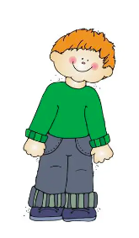
stand up
stand up /ˈstænd ʌp/ 起立, 站起来

Slide 10
help
help /help/ v. 帮助
help sb(somebody) do(动词原形) sth(something) 帮助某人做某事
E.g. He is helping Tim paint the wall.
他正在帮Tim粉刷墙面。
help sb with sth 帮助(做)某人某事
E.g. She is helping me with my math problem.
她正在帮我解答数学问题。

Slide 11
at once
at once 立即

Slide 12
sure
sure /ʃuə(r)/ adj. 一定的, 确信的
for sure 确实

Slide 13
X-ray
X-ray /ˈeks reɪ/ n. X光透视

Slide 14
Listen and answer the question:
Must Andy go to see the doctor?

Slide 15
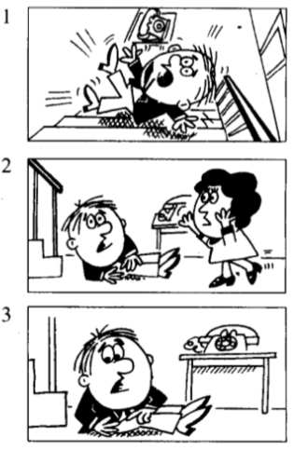
ANDY: Ow!
LUCY: What’s the matter, Andy?
ANDY: I slipped and fell downstairs.
LUCY: Have you hurt yourself?
ANDY: Yes, I have.
I think that I’ve hurt my back.
fell downstairs 从楼梯上摔下来, downstairs是副词, 修饰fell, 作状语。

Slide 16
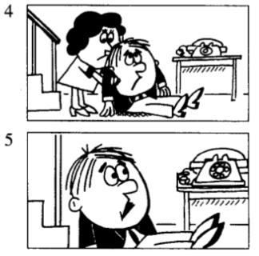
Try and stand up. 试着站起来。在英语中，常用and把两个动词连接在一起，如come upstairs and see it。这种句子往往用来鼓励某种动作。
LUCY: Try and stand up.
Can you stand up?
Here. Let me help you.
ANDY: I’m sorry, Lucy.
I’m afraid that I can’t get up.
Here在这里是感叹词，意思是“来”或“喂”，引起别人注意。
Let me help you. 让我来帮你。其中let有“允许”的意思。
注意在let后面要加不带to的动词不定式。

Slide 17
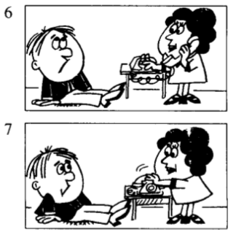
LUCY: I think that
the doctor had better see you.
I will phone Dr. Carter.
LUCY: The doctor says that
he will come at once.
I’m sure that
you need an X-ray, Andy.
The doctor says that he will come at once. 在英语中如果要把某人所说的话告诉另一个人要用间接引语。间接引语不用引号，往往在引语前加引导词that。

Slide 18
直接引语 vs. 间接引语
直接引语: 在陈述句中,直接引用说话人原来的语句,直接引语用引号。
E.g. She says, “look at theses flowers.” 她说“看这些花”。
间接引语：用自己的词语来转述表达原来说话人说的内容。
E.g. She says that look at these flowers. 她说看这些花。
直接引语变为(→)间接引语：
1)双引号改为连接词that(*that引导宾语从句),有时that可省略。
2)人称变化 3）时态变化:主句为过去时，间接引语“现在”变成“过去”。
E.g. She said, “I’m at the doctor’s office. ”她说,“我在医院”。
She said that she was at the doctor’s office.她说她在医院。

Slide 19
参考译文
安迪：啊呦！
露西：怎么了，安迪？
安迪：我滑了一跤，从楼梯上摔下来了。
露西：你摔伤了没有？
安迪：是啊，摔伤了。我想我把背摔坏了。
露西：试试站起来。你能站起来？来，让我帮你。
安迪：对不起，露西，恐怕我站不起来。
露西：我想最好请医生来给你看一下。我去给卡特医生打电话。
露西：医生说他马上就来。安迪，我看你需要做一次X光透视。

Slide 20
Role-play

Slide 21
Lesson 100
He says that…
She says that…
They says that…

Slide 22
New Words and expressions
license /ˈlaɪsns/ n. 执照
driver license 驾照

Slide 23
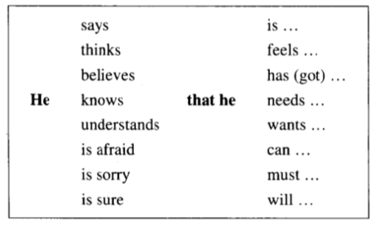
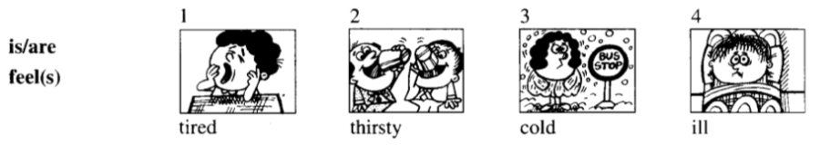

Slide 24
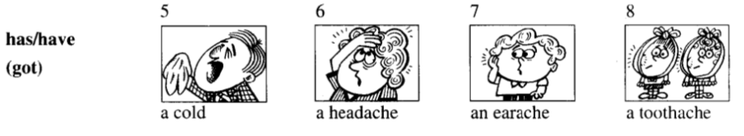

Slide 25
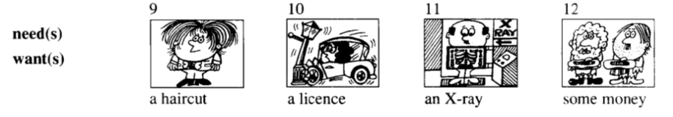

Slide 26
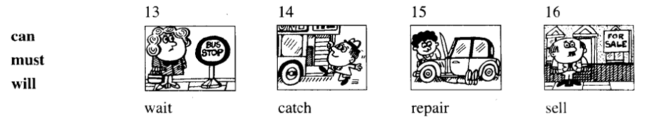

Slide 27

Homework
1. 抄写单词3遍，完成课后习题
2. 练习L99课文对话

